Slide 1
What is Kickstarter?
A crowdfunding platform for creative project owners
Independent organization based in Greenpoint, Brooklyn
Funding - “all-or-nothing”
Funding goal, creator, backers, rewards
Project creators keep 100% ownership of their work

Slide 2
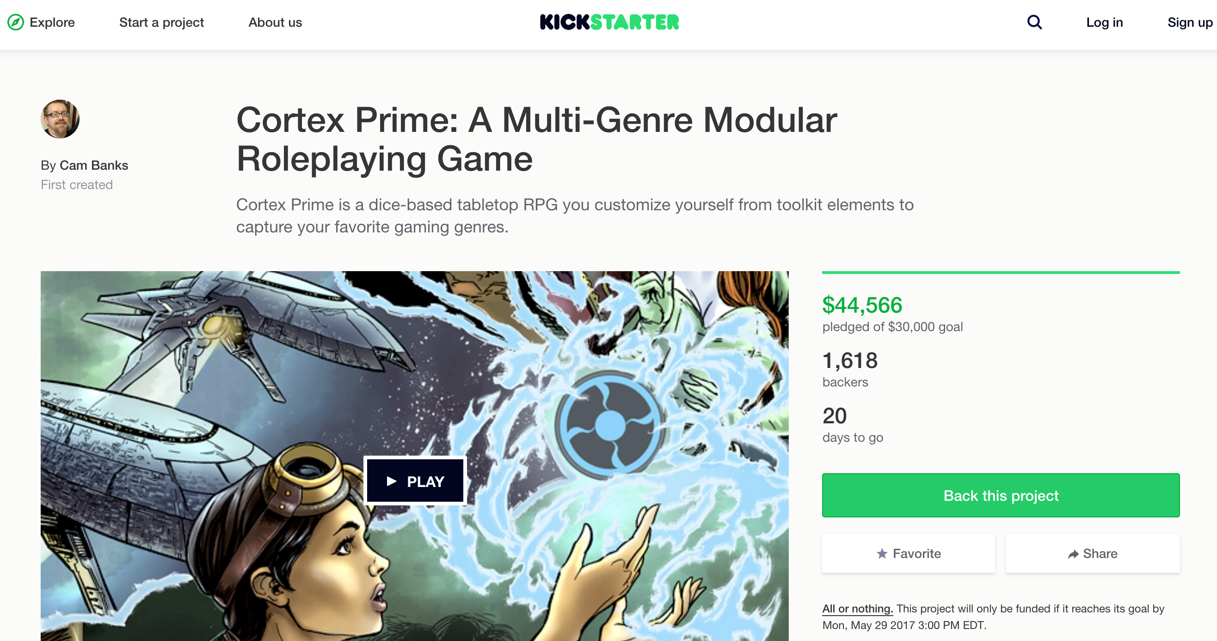
Example : A project page

Slide 3
Webscraping kickstarter.com Selenium + Chrome Browser
Initial Project goal:
To scrape data for all the successful projects till date in all 15 categories based in the United States
Successful projects Over-ambitious!?! Guess so!
World-wide : 124,060
United States : 98,162
Selenium and Chrome did not co-operate
Revised Project goal :
Scrape data for the top 100 projects in each of the 15 categories
Based on Kickstarter’s “magic” sort

Slide 4
Research questions
What categories of project receive more funding?
Do longer campaigns raise more money?
What categories have more backers?
Target Audience
Budding entrepreneurs/creative project creators
Crowdfunding enthusiasts, interested in trends and to be part of the creative process

Slide 5
Data Scraped
Category
URL (project)
Subcategory
Project Name
Creator
Project location
Goal amount
Pledged amount
Backers
Funding start date
Funding End date

Slide 6
Data Pre-processing & Transformation
Converting ”Date” fields to datetime fields
Converting money fields to numeric
For few projects – amount in CA$ and £ - converting to USD with exchange rate
Split location City and State
Adding derived columns for funding %, funding duration

Slide 7
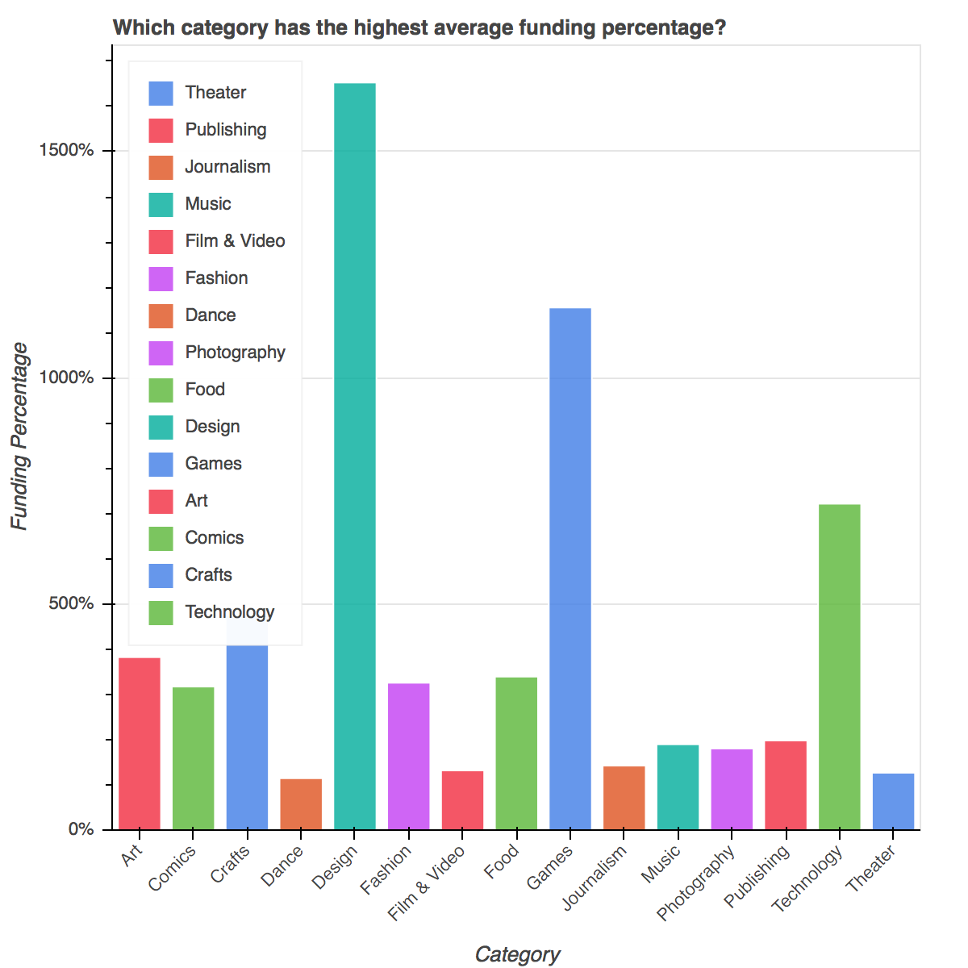
Exploratory Analysis Top funded categories
Top 5 highest funded categories
Design
Games
Technology
Crafts
Art

Slide 8
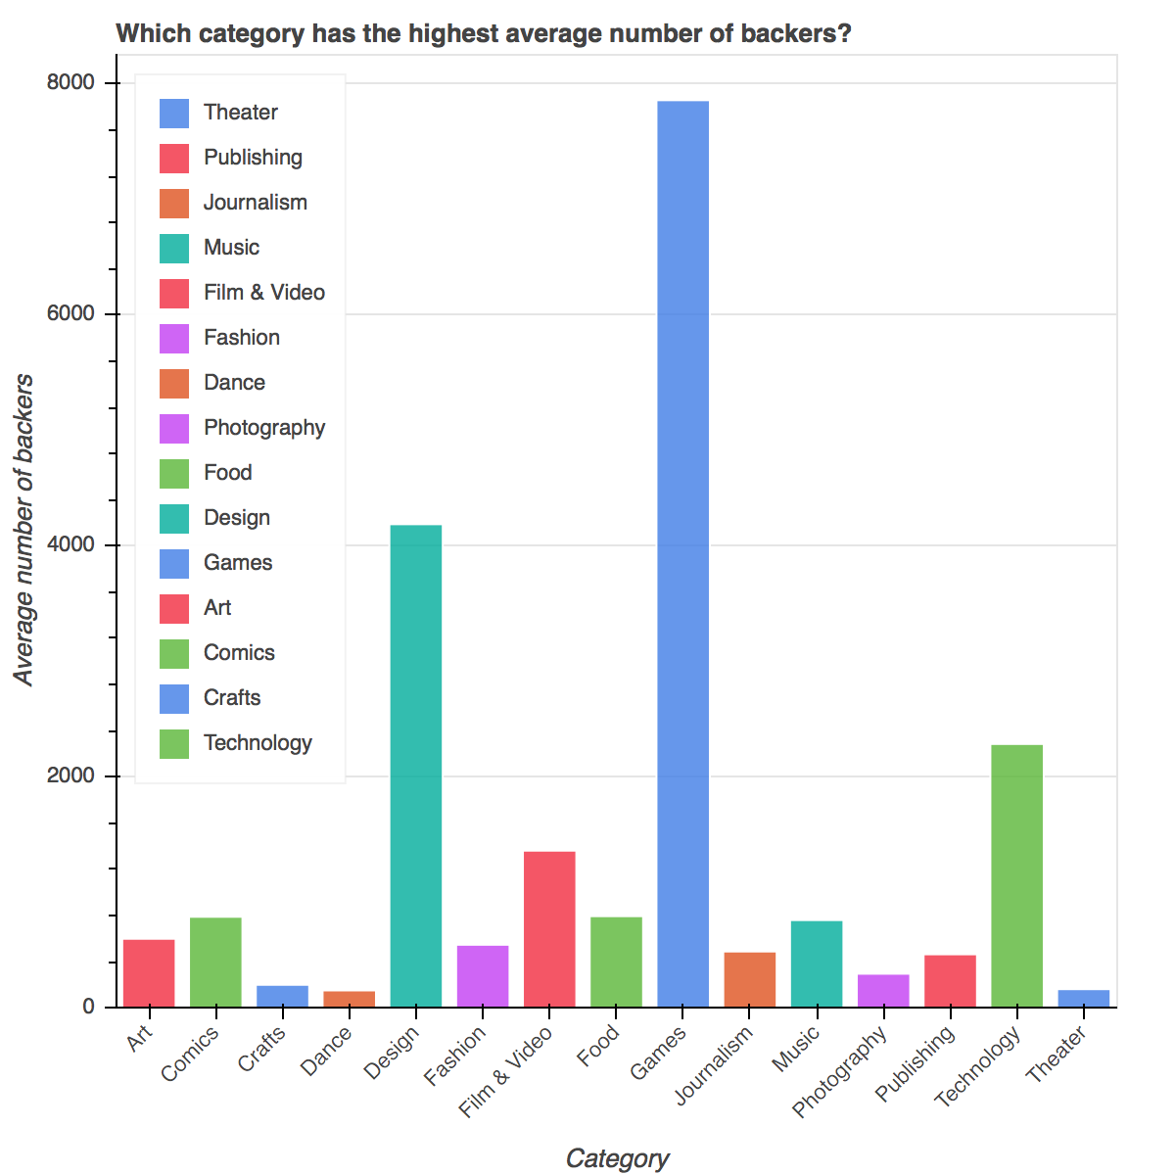
Exploratory Analysis Top categories with highest backers
Top 5 categories in terms of backers
Games
Design
Technology
Film & Video
Comics

Slide 9
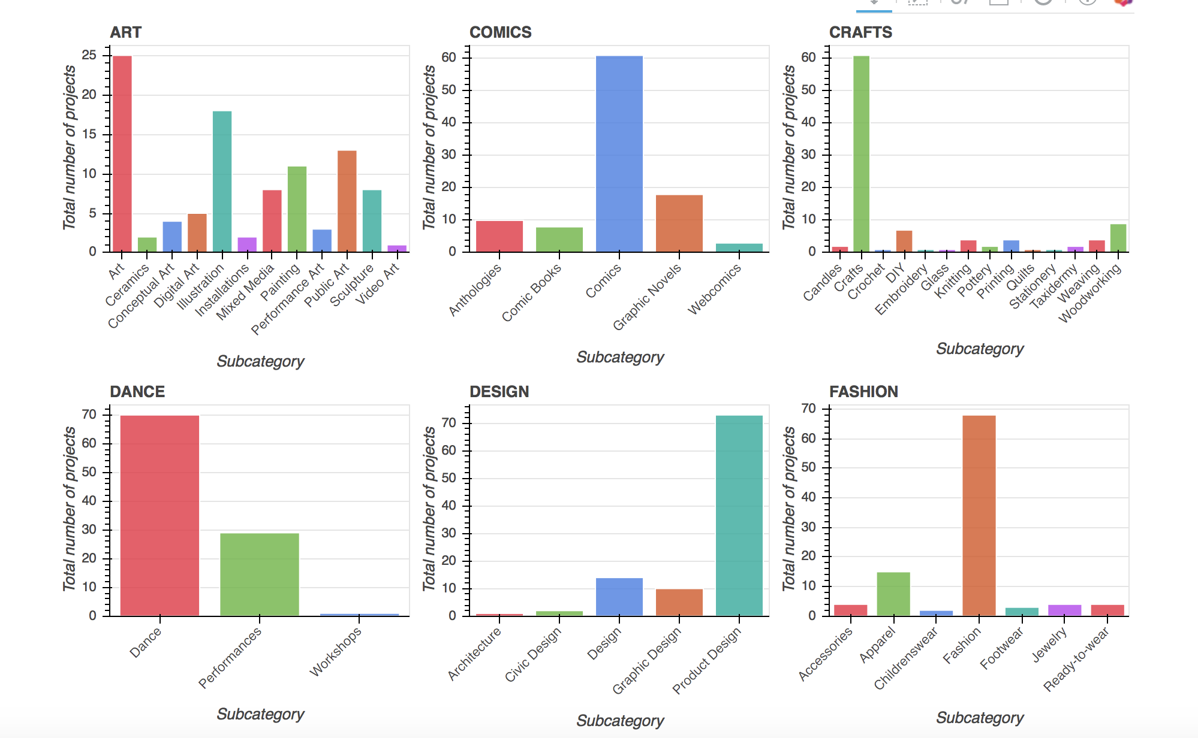
Exploratory Analysis Highest number of projects by Sub-category

Slide 10
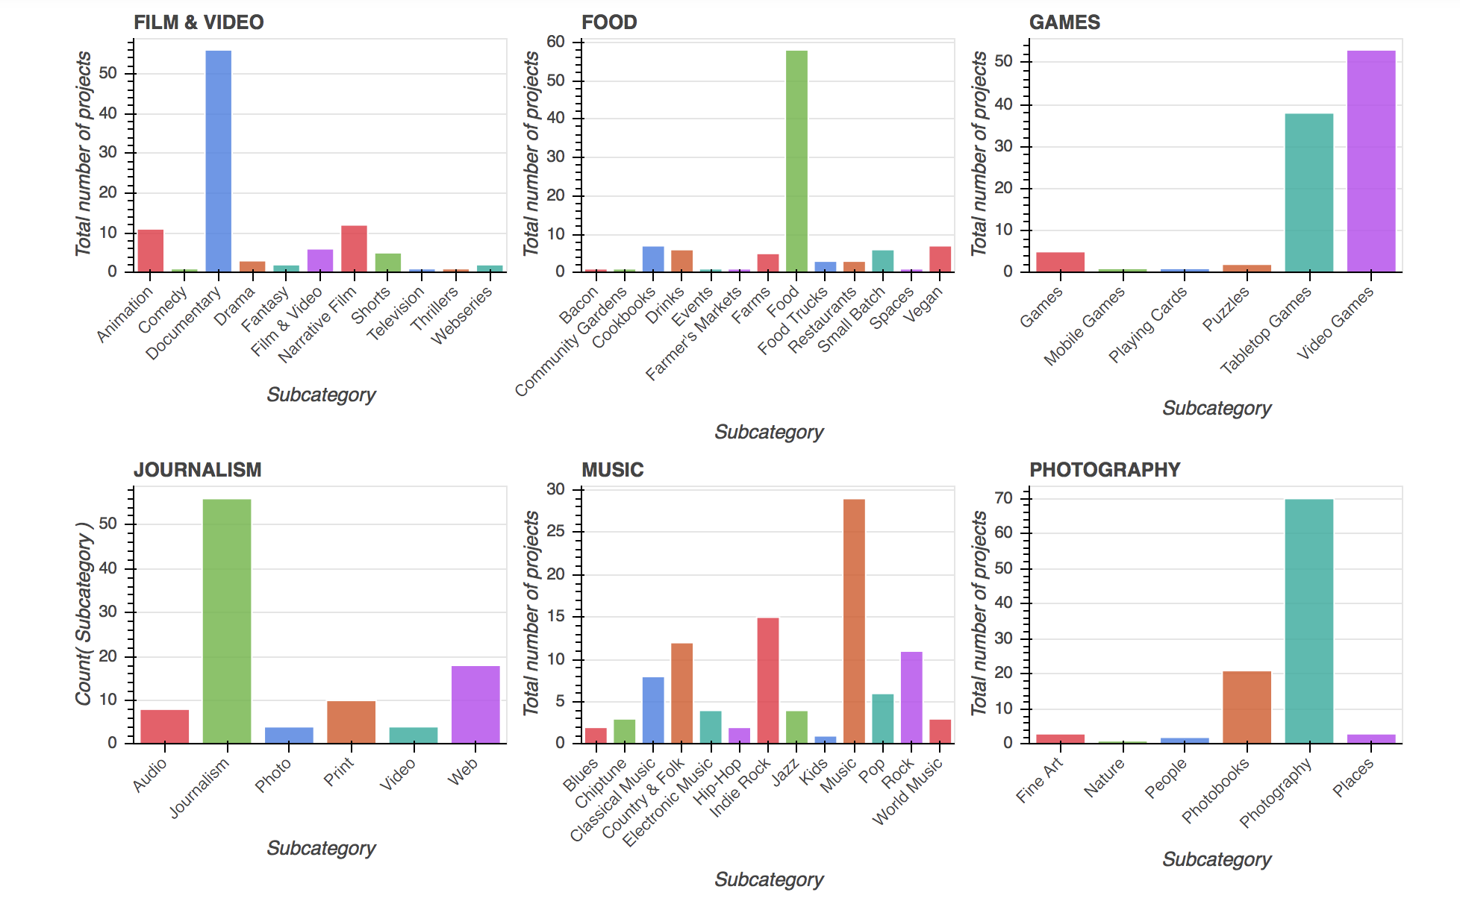
Exploratory Analysis Highest number of projects by Sub-category

Slide 11
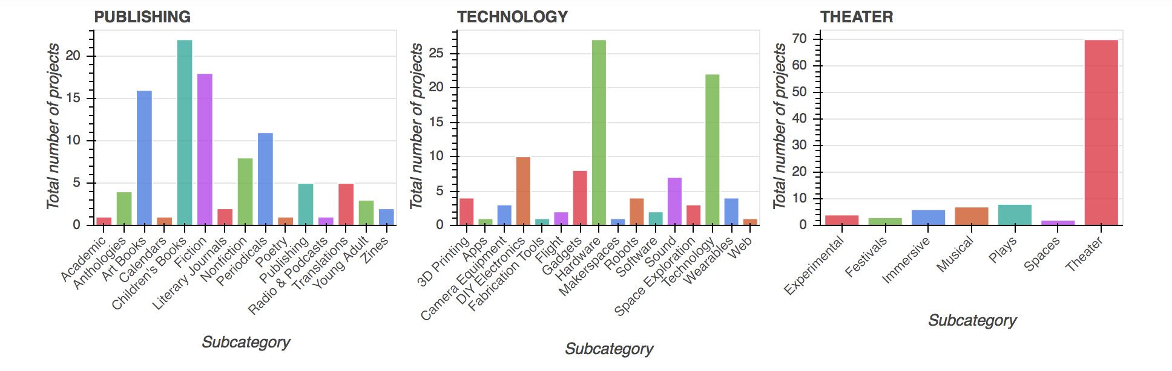
Exploratory Analysis Highest number of projects by Sub-category

Slide 12
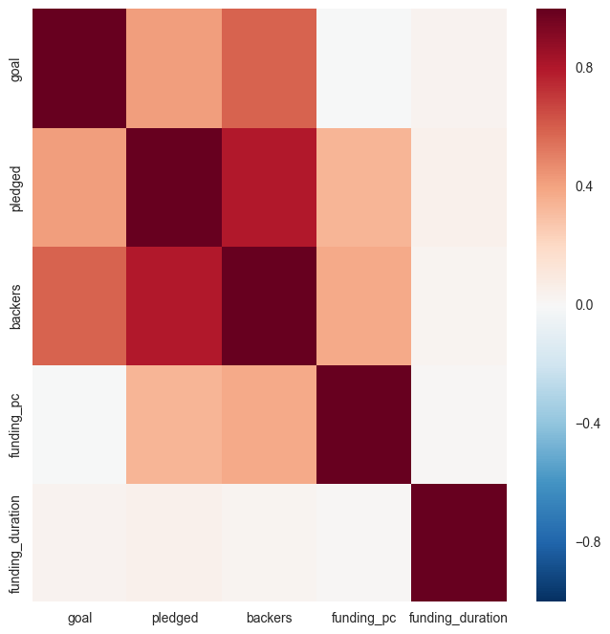
Correlation Heat Map
Longer campaigns do not necessarily raise more money

Slide 13
Where are the Kickstarters? (Top 3 locations)
Category | State | Project Count
Art | NY | 30
 | CA | 22
 | MA | 7
Crafts | CA | 18
 | PA | 9
 | NY | 8
Comics | CA | 25
 | NY | 13
 | IL | 10
Dance | NY | 48
 | CA | 11
 | TX | 8
Design | NY | 34
 | CA | 24
 | IL | 9
Food | NY | 28
 | CA | 20
 | TX | 13
Category | State | Project Count
Games | CA | 24
 | WA | 16
 | TX | 13
Journalism | NY | 31
 | CA | 14
 | TX | 5
Music | CA | 27
 | NY | 24
 | WA | 9
Photography | NY | 30
 | CA | 23
 | IL | 7
Publishing | NY | 23
 | CA | 21
 | OR | 14
Technology | CA | 42
 | NY | 13
 | MA | 11
Theater | NY | 39
 | CA | 12
 | IL | 12

Slide 14
Key Compelling Takeaways
Extensive variation in crowd funding dynamics
Example: Design category exceeding goals by over 1500% while Dance saw minimum surplus
Longer campaign duration does not necessarily raise more fund
Design had the highest funding percentage while Games attracted the most backers.

Slide 15
Future Direction
Analyze the different pledge tiers and the reward system
Analyze if the description of a project has any correlation to the success rate of the project – NLP, word cloud
Apply Machine Learning to predict the success probability of live projects
Comparative analysis of different crowdfunding platforms

